Slide 1
Instructions on Data and Code Usage
Jiapeng Yin
Jiapeng.yin@lglab.ac.cn
Lingang Laboratory, Shanghai, China
2025-06-17

Slide 2
Figure 2e,h, Figure 3a and Extended Data Figure 4, 5

Slide 3
1. Code and data preparation
Unzip the code folder. It is recommended to use VS-code(Visual Studio Code - Code Editing. Redefined) open as a project with Python 3.12 interpreter (You need to install python packages pandas, etc).
Place the code in an appropriate directory.
Place the DATA folder in your desired path ($DATA_PATH).
Open the CODE folder as a project in VS-code.
Replace the pn_root variable in each script to your $DATA_PATH.

Slide 4
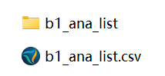
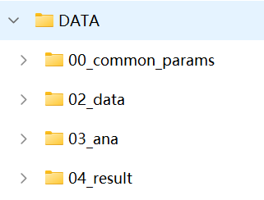
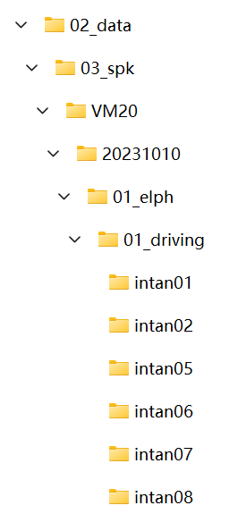
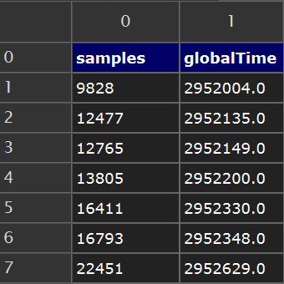
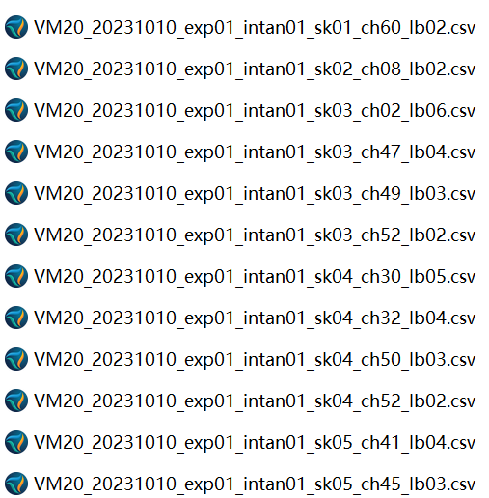
DATA folder:
Processing list bak
Processing list
Channel information
Spike data
Generated processing list
Plotted results
Animal name
Samples in recording system
Syncned to globalTime, ms
Experiment date
Data type
Task name
Spike files
Data collection devices

Slide 5
2. Generate data processing list
Run b1_gen_ana_list.py:
1. Open the file and modify the DATA folder path pn_root :
pn_root = r"\\NJJK-NAS\visual\66_paper\MANUSCRIPT\20250610-v6-submit\figShare_upload\DATA"
Replace it with your local path ($DATA_PATH).
2. Running this script will generate a data processing list (b1_ana_list.csv) at:
$PATH_DATA\03_ana\00_list\b1_ana_list.csv
This file contains all unit information, file paths, and result storage locations, which will be used in subsequent steps.

Slide 6
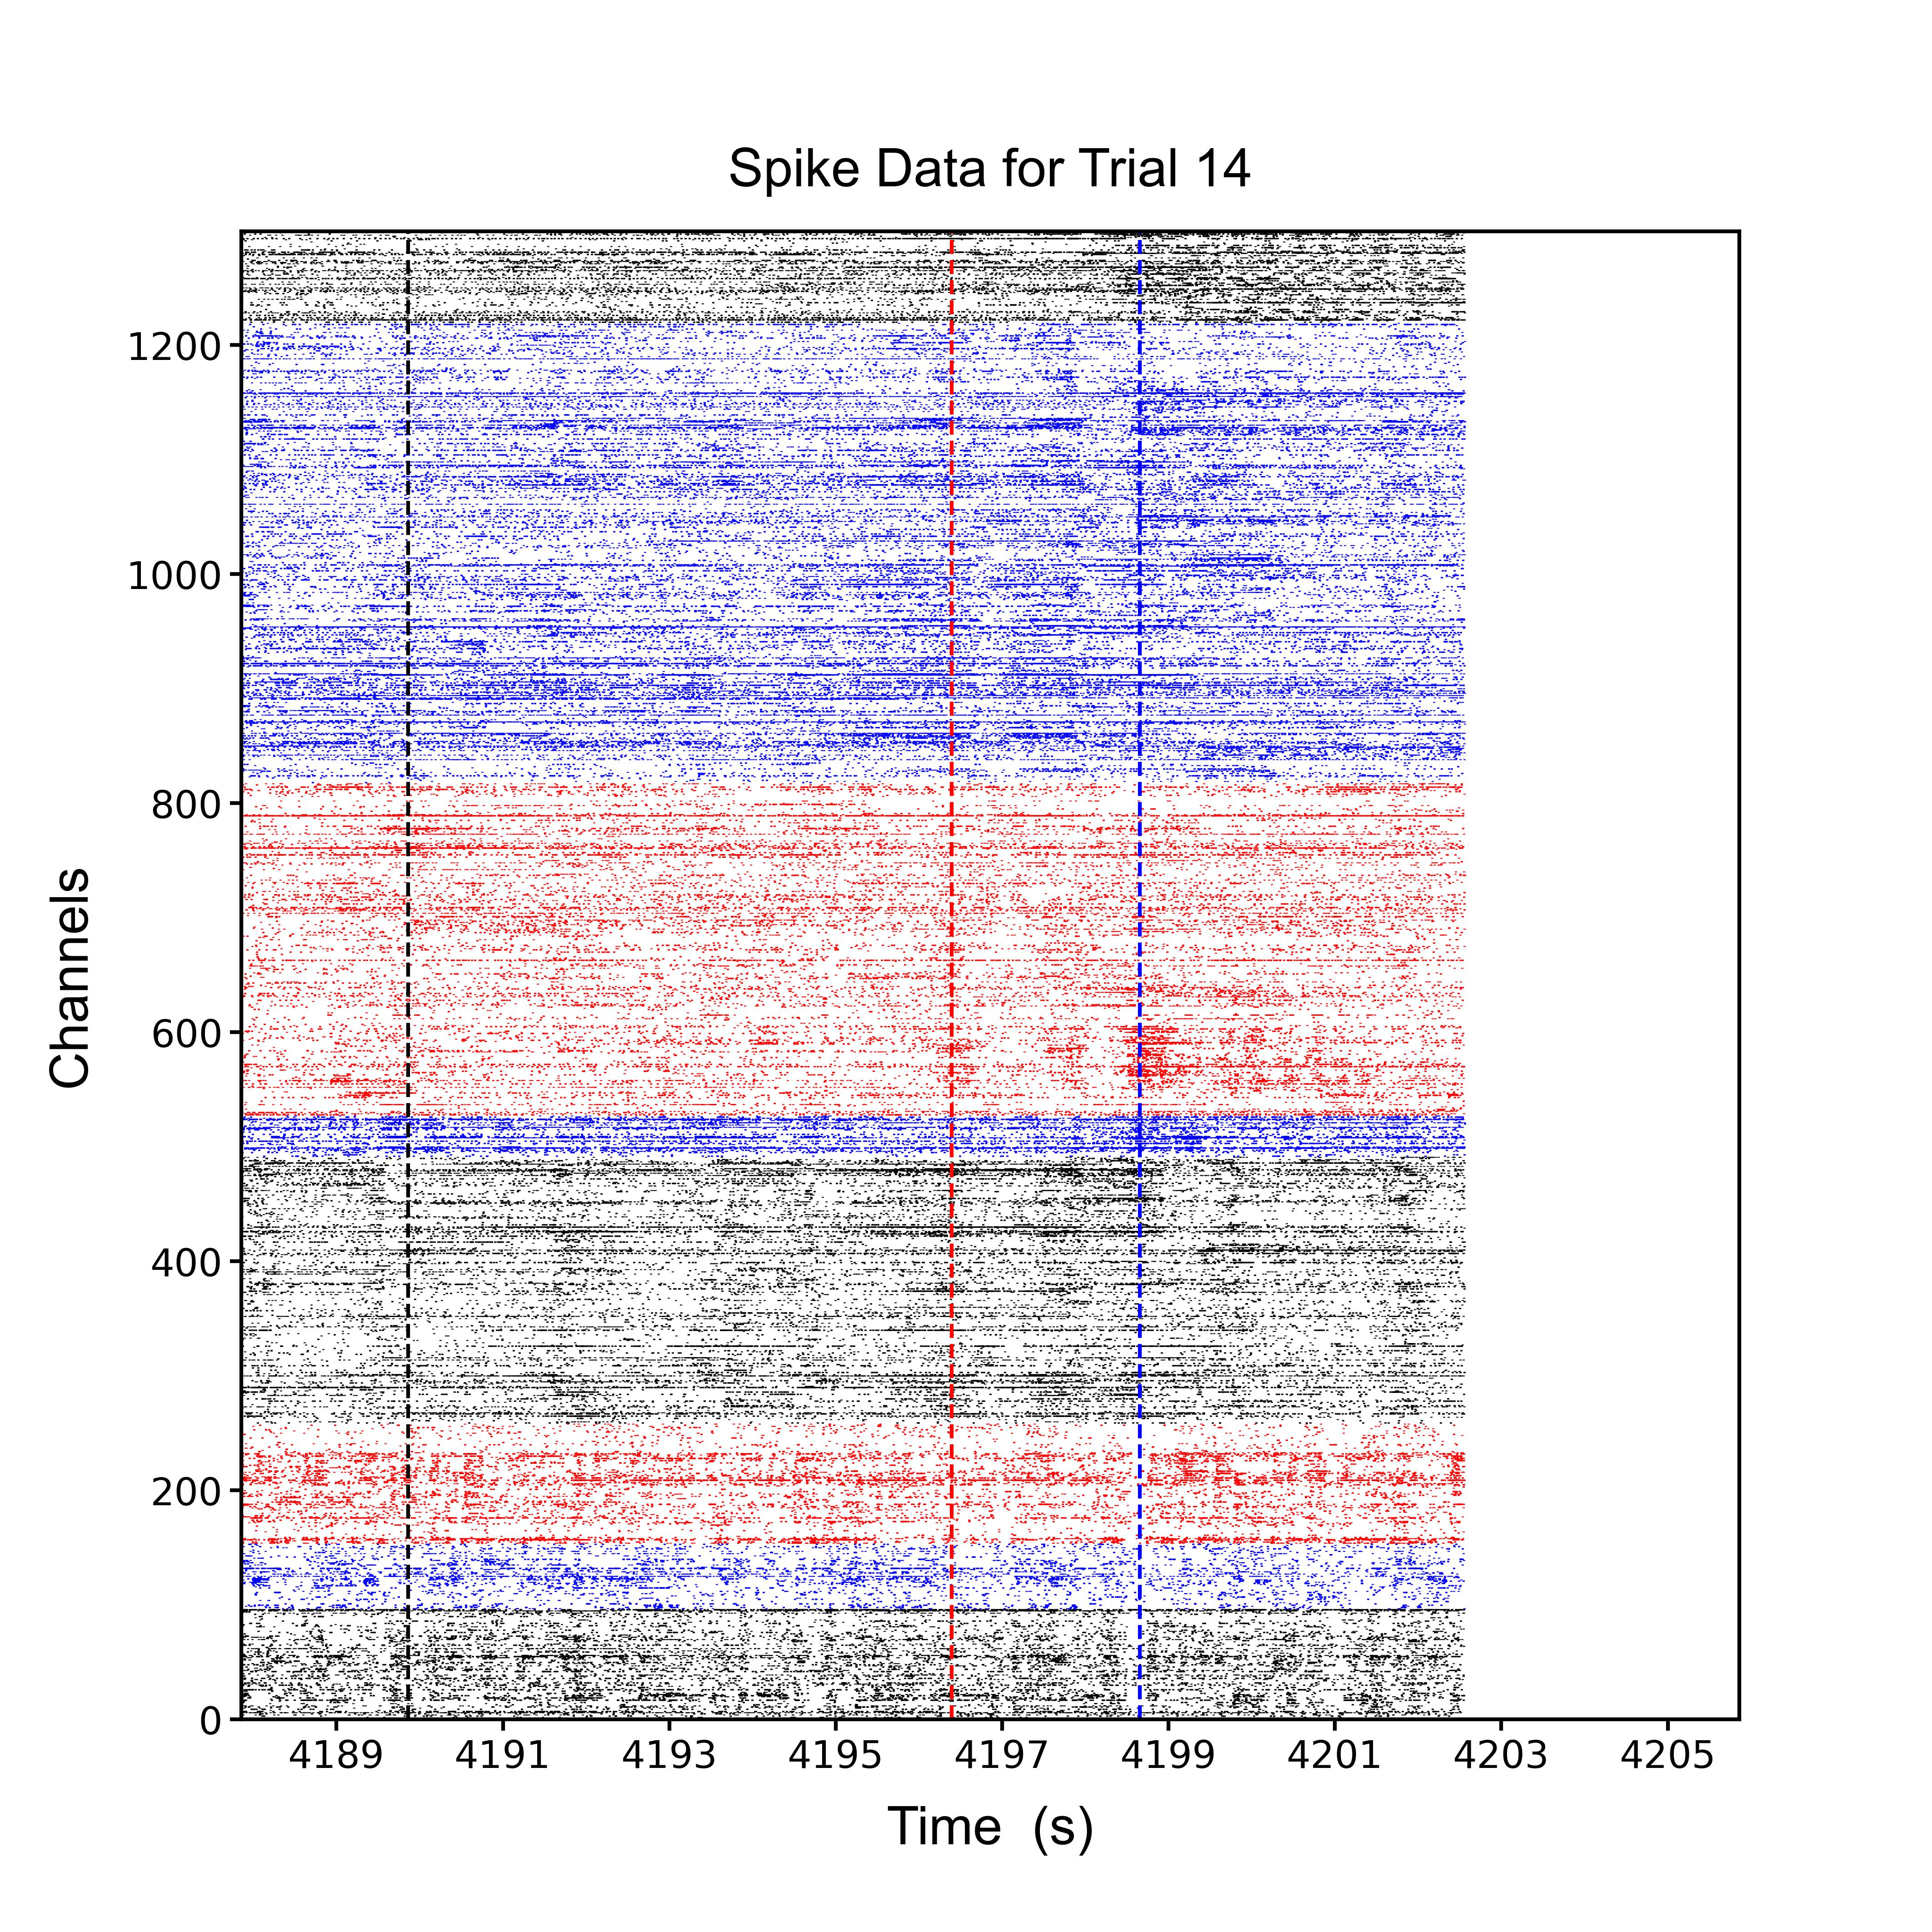
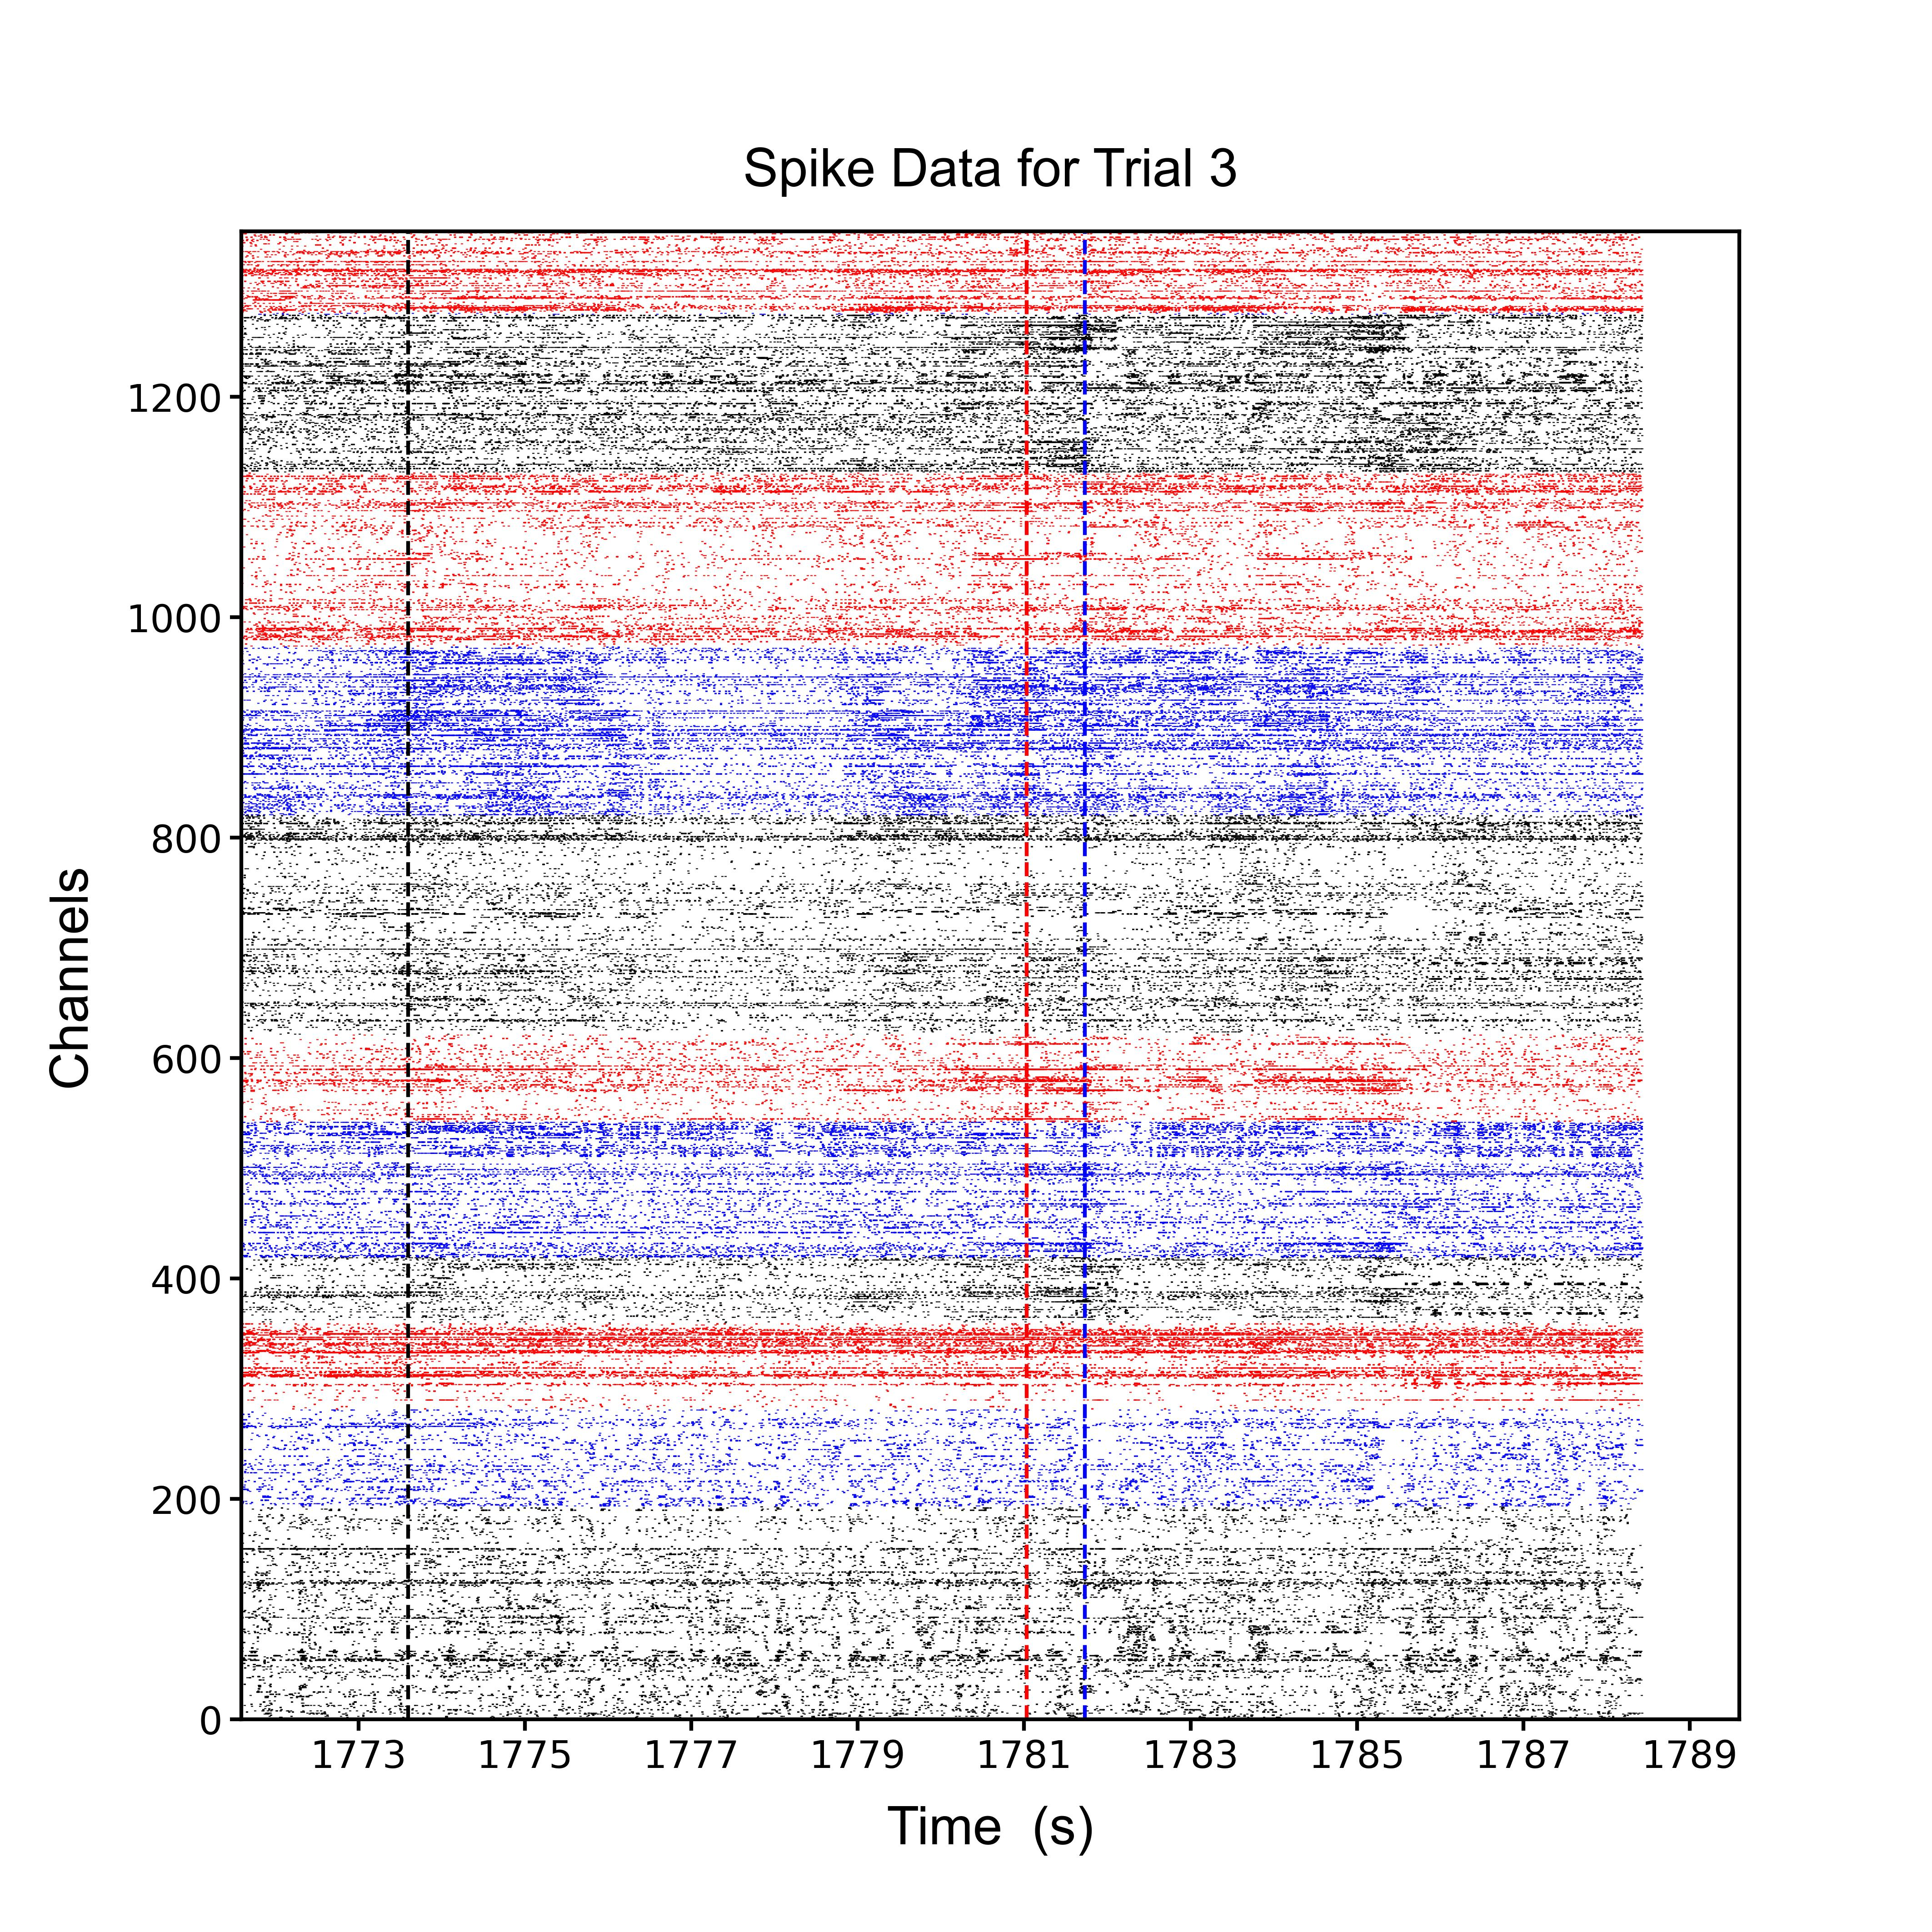
3. Plot Trial Raster:
After the previous step, open $CODE_PATH/b2_plot_raster.py.
Replace pn_root with your $DATA_PATH
Results will be saved in: $DATA_ PATH\04_result\b2_raster， (e.g., VM20 and VM23 are animal names.)
Customizing Brain Region Colors:
Modify the color scheme by changing: color = processing_row['color_bak']
Replace 'color_bak' with any of the following fields in b1_ana_list.csv: color, color_VM20, color_VM23, color@20230315, color_bak, or other colors you defined
4. You will get figures like:
in several minutes.

Slide 7
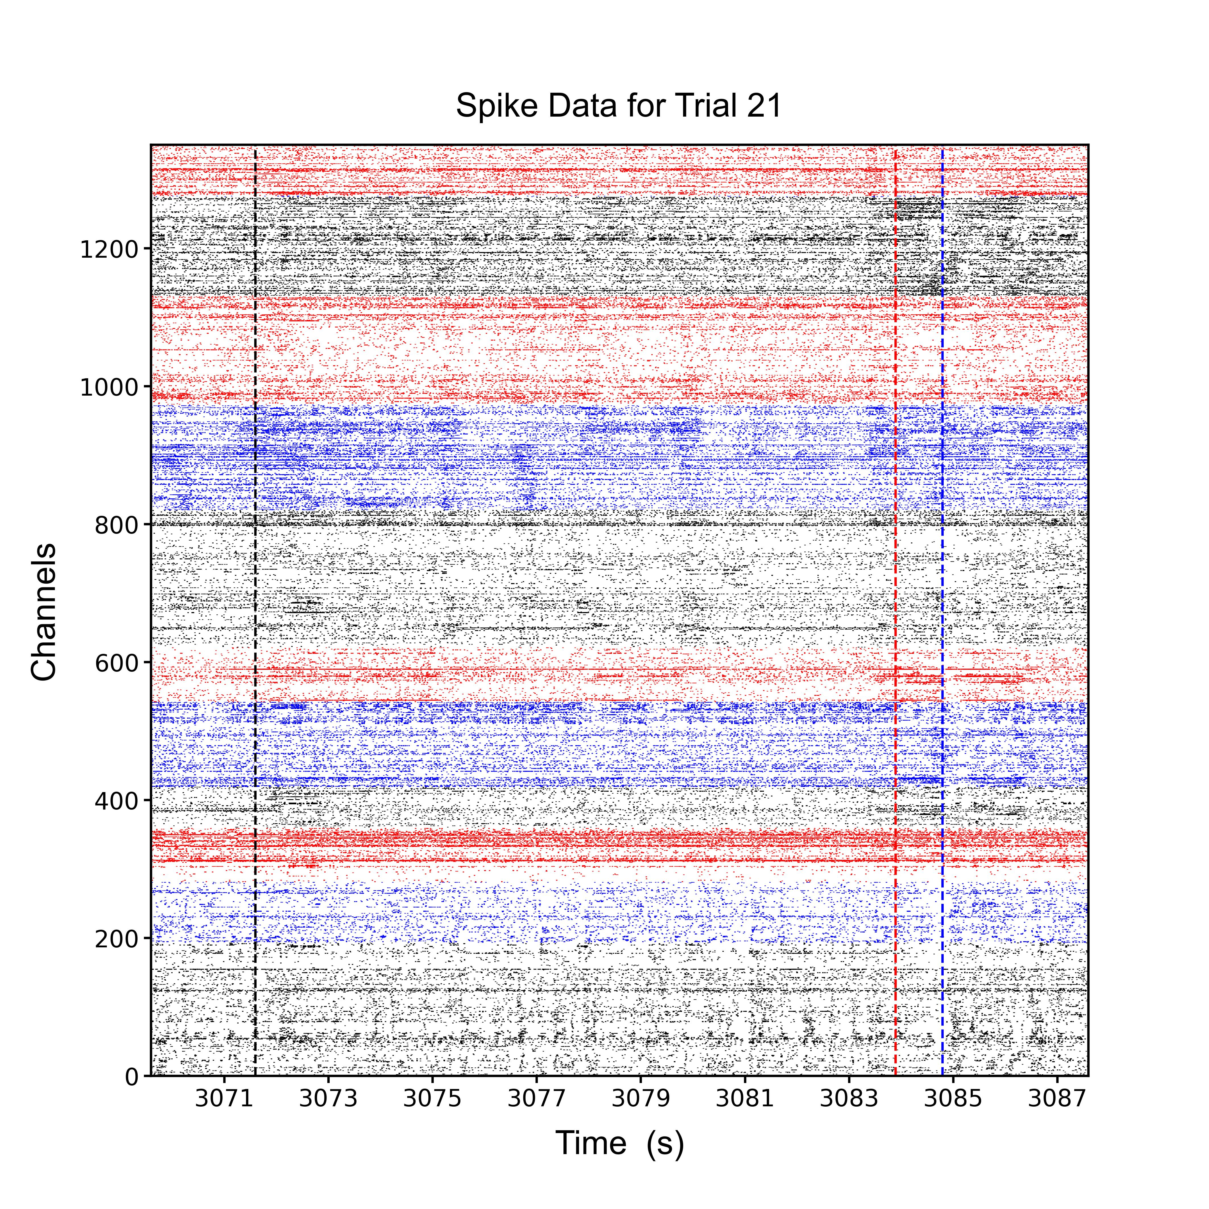

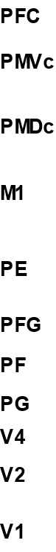
3. Plot Trial Raster: result figures
Events: reach_start, touch_fruit, touch_mouth
Animal VM20
Animal VM23

Slide 8
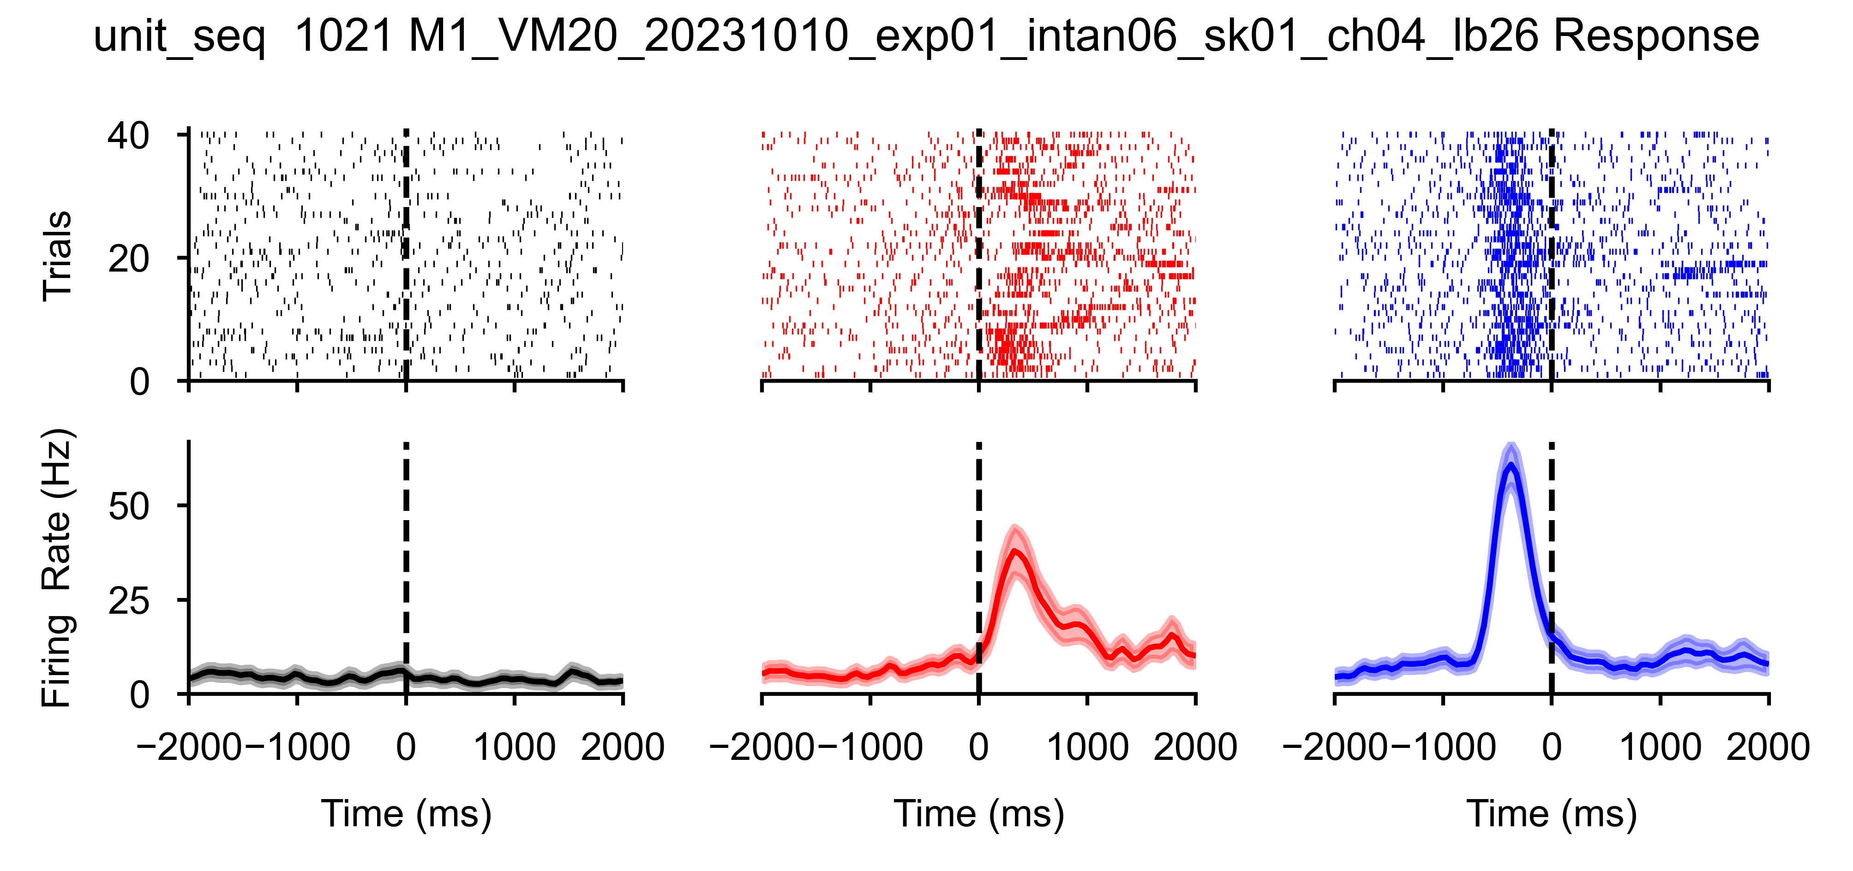
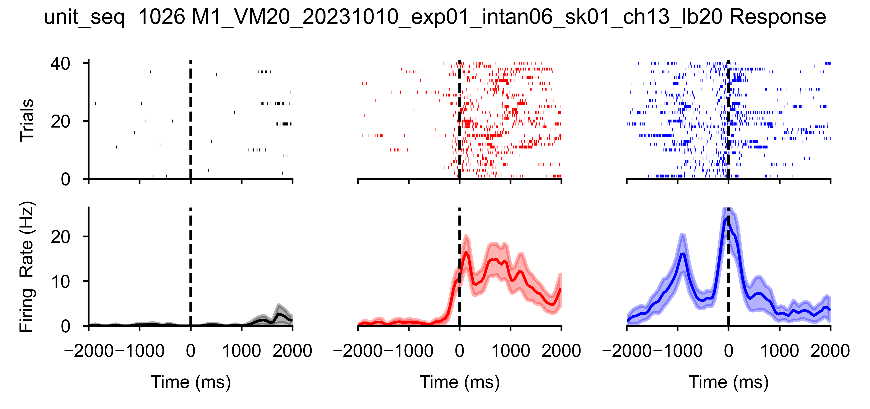
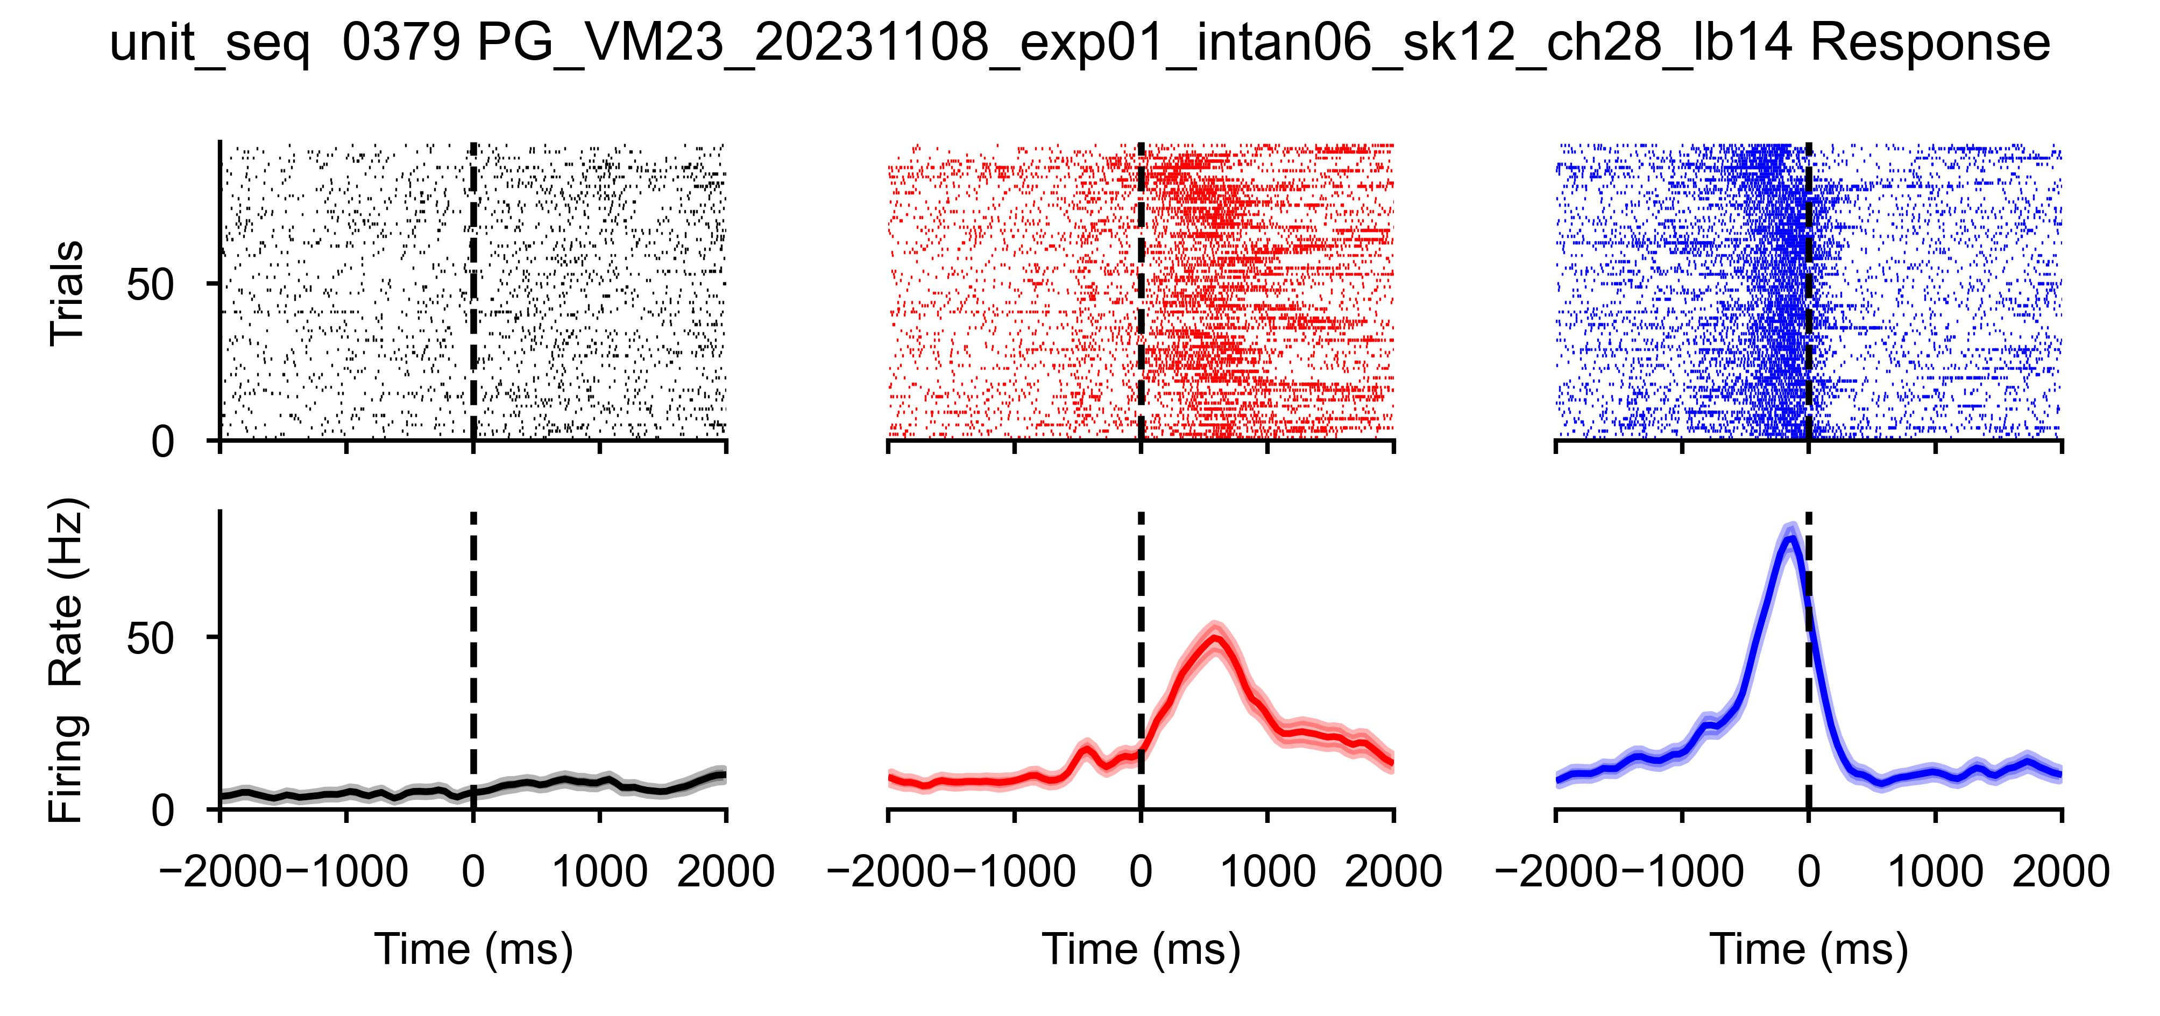
4. Plot Task Raster by Unit:
Open $CODE_PATH/b3_plot_task_raster.py
Replace pn_root with your $DATA_PATH
The script will load b1_ana_list.csv and generate plots for each unit.
Color Scheme in Plots:
Black = reach_start
Red = touch_fruit
Blue = touch_mouth
4. You will get figures like the following figures in 10-20 minutes, depends on your CPU.

Slide 9
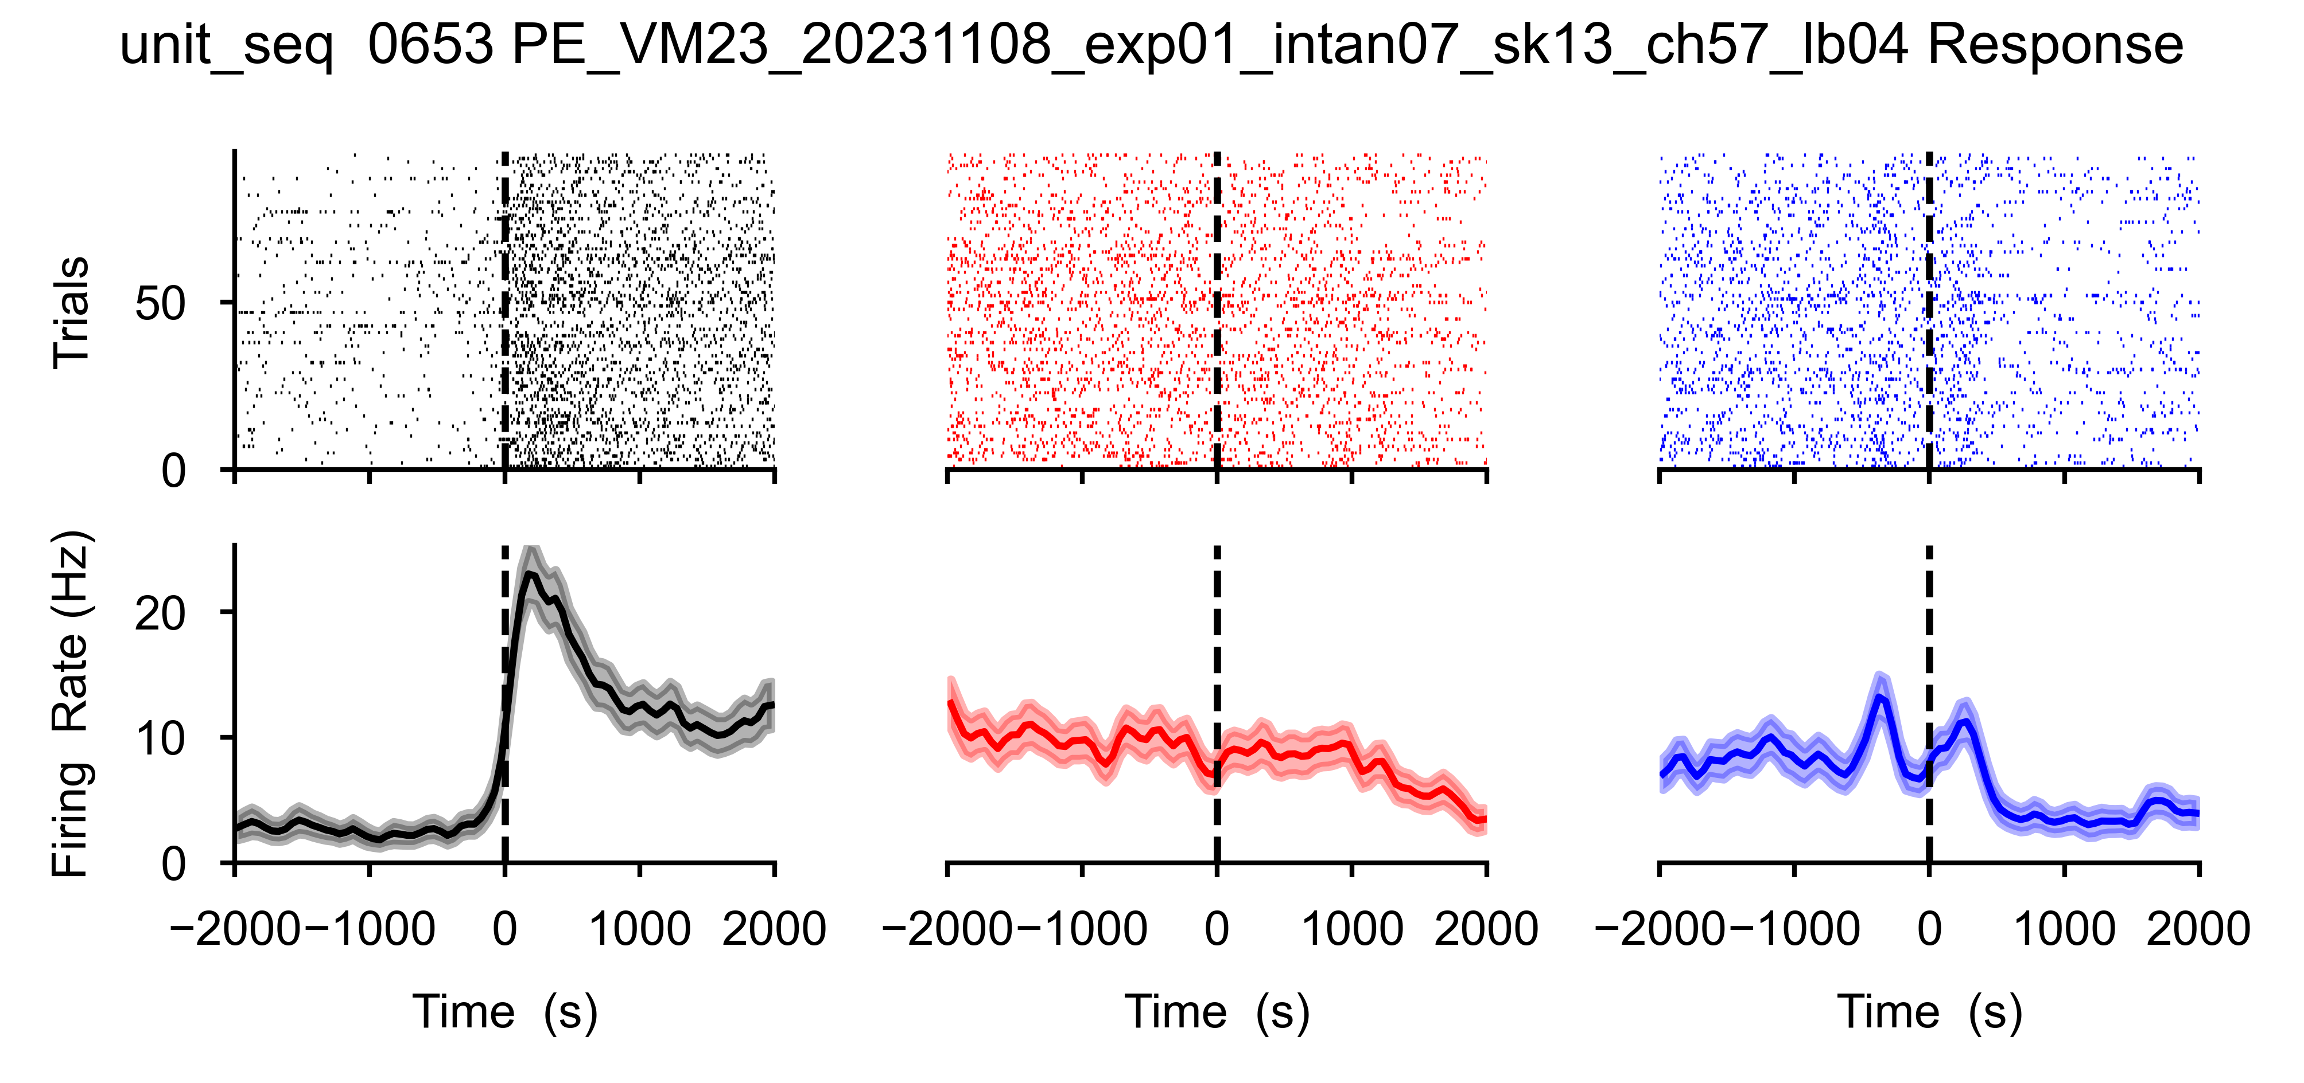
4. Plot Task Raster by Unit: result figures
Brain area
Date
Rec system
Channel
Unit seq
Animal name
Experiment
Shank
Events: reach_start, touch_fruit, touch_mouth

Slide 10
Figure 3c and Extended Data Figure 6

Slide 11
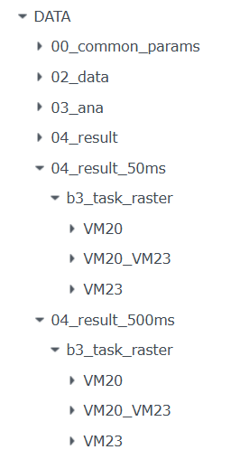
1. Calculate Firing Rates per Unit:
Open $CODE_PATH/b4_extract_fr.py.
Replace pn_root with your $DATA_PATH
Modify variable bin_size to get 50ms bin FR and 500ms bin FR respectively for later use.
Run twice at 50ms, and 500ms bin_size, respectively.
The script will load b1_ana_list.csv and save the mean firing rates for each unit to $PATH_DATA/04_result_{bin_size}ms.
Run $CODE_PATH/b4_merge_data.py to merge the data from VM20 and VM23 into a new folder named VM20_VM23.

Slide 12
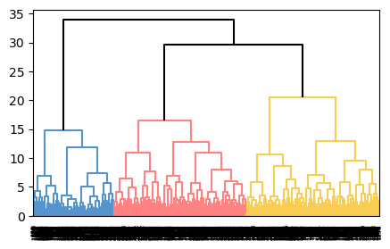
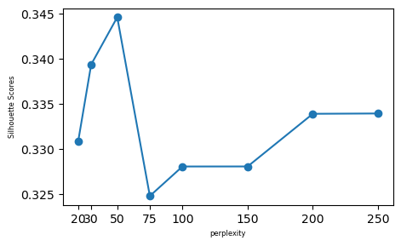
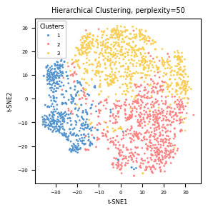
2. Hierarchical Clustering:
*.ipynb files are Jupiter notebook file type. You need to install Jupiter along with VS-code.
Run $CODE_PATH/Figure_3c.ipynb step by step. This notebook is used to generate the following plots (Figure 3c and Extended Data Figure 6):
Replace pn_root with your $DATA_PATH and run the code.
Perform hierarchical clustering by Ward’s method: Units were classified into three clusters.
Visualization of neuronal firing rates on a low dimensional space: dimension reduction were performed using t-distributed stochastic neighbor embedding (t-SNE), and the optimal perplexity value for t-SNE analysis were determined by finding the highest silhouette score.

Slide 13
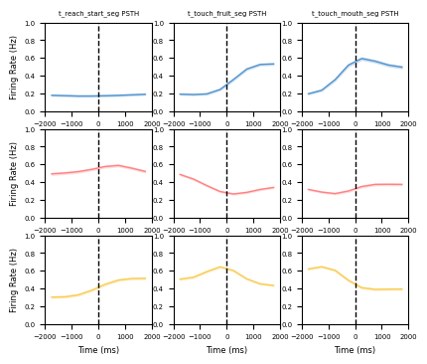
3. Normalized Average Firing Rate:
Run $CODE_PATH/Figure_3d.ipynb step by step. This notebook is used to generate the following plot, showing the normalized average firing rate for three clusters aligned to the onset of three behavioral epochs (Figure 3d):
Replace pn_root with your $DATA_PATH and run the code.
The firing rates for each unit during three behavioral epochs were Min-max normalized to the range (0, 1).

Slide 14
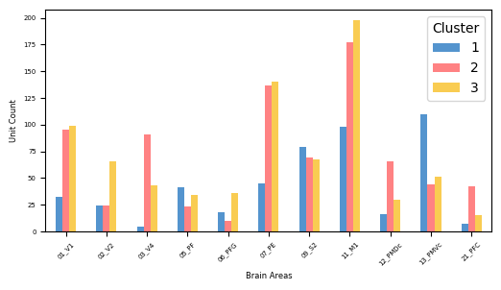
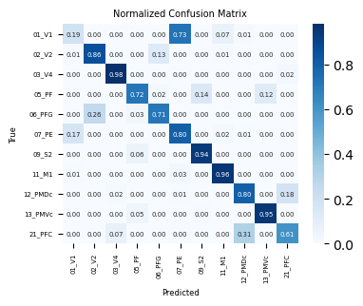
4. SVM Classification:
Run $CODE_PATH/Figure_3ef.ipynb step by step. This notebook is used to generate the following plots (Figure 3e and Figure 3f):
Replace pn_root with your $DATA_PATH and run the code.
The polynomial kernel for the classifier is selected based on its high accuracy.
The confusion matrix was normalized per class by dividing each element in the matrix by the sum of elements in the corresponding row.

Slide 15
Instructions on Behavior Recording Videos
The videos were recorded with OBS Studio at 3840×2160@30Hz framerate
VM20@20231010.mkv was animal VM20 performed task at 20231010
VM23@20231108.mkv was animal VM23 performed task at 20231108

Slide 16
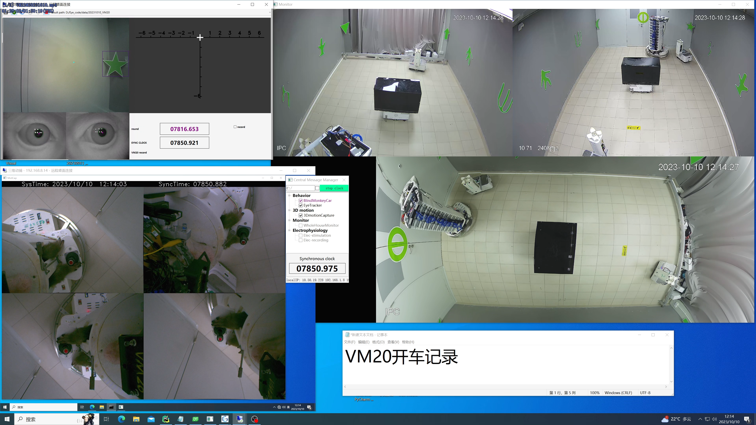
1. Remote screen and video stream recording simultaneously (VM20@20231010.mkv)
Remote screen of eye tracking
Video stream from remote cameras
Scene camera
Roof camera at front
Roof camera at rear
Visualization of stimulated RFs
only in electrical stimulation tasks
Object Detection Timestamps
Eye Tracking
Remote screen of hand motion capture
Roof camera at top
Hand Camera 4-2
Hand Camera 4-1
globalTime for synchronization
Hand Camera 4-3
Hand Camera 4-4

Slide 17
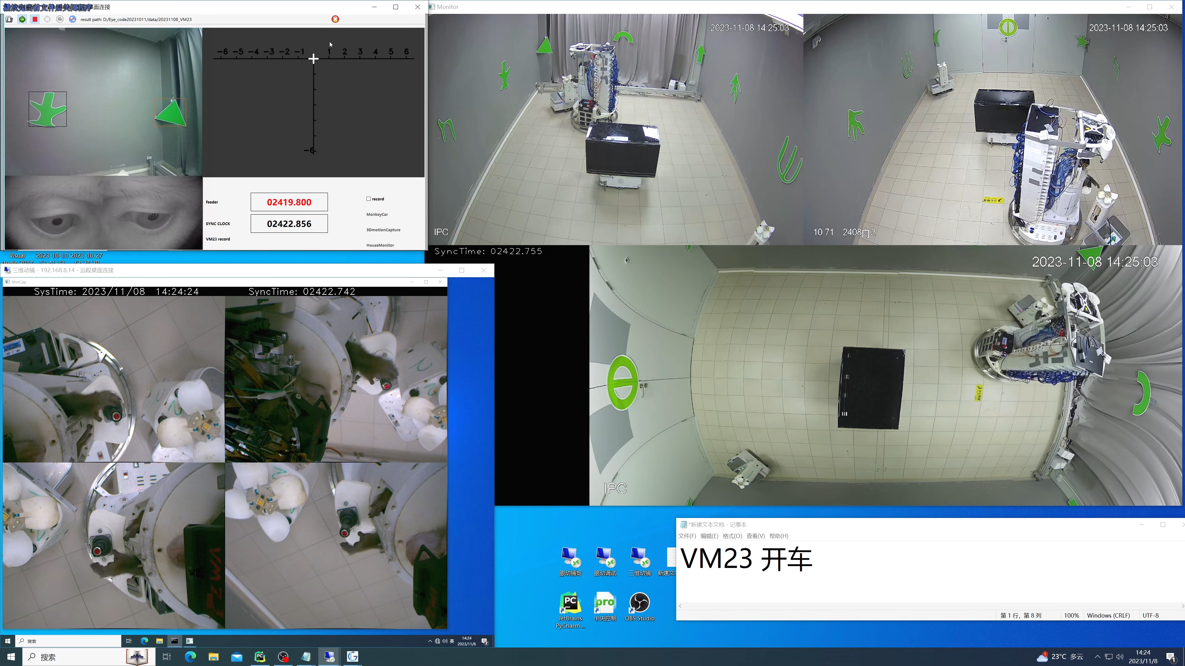
2. Remote screen and video stream recording simultaneously (VM23@20231108.mkv)
Remote screen of eye tracking
Video stream from remote cameras
Scene camera
Roof camera at front
Roof camera at rear
Visualization of stimulated RFs
only in electrical stimulation tasks
Object Detection Timestamps
Eye Tracking
Hardware connection status
Remote screen of hand motion capture
Roof camera at top
Hand Camera 4-2
Hand Camera 4-1
globalTime for synchronization
Hand Camera 4-3
Hand Camera 4-4

